Slide 1

SAFETY TRAINING
FOR SURVEYORS

Slide 2

FIRST AID & CPR
Basic First Aid
(Click the link above to watch video!)

Slide 3
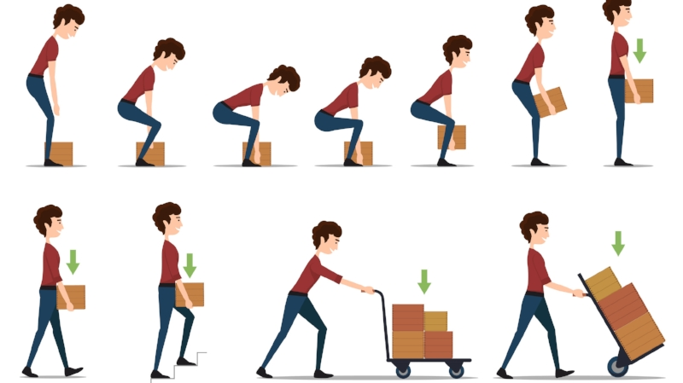
PROPER LIFTING PROCEDURES

Slide 4
If you are going to lift something by hand and the load is compact enough to pass between your knees, use the following steps:
Your feet should be apart, with one foot alongside the object to be lifted and one foot behind. Spreading your feet like this gives you greater stability and your rear foot will be in a position for upward thrust of your lift. It also gives your body better positioning over the object you are lifting.
Use the sit-down position and keep your back straight, but remember that straight does not mean vertical. The trick is to keep the spine, back muscles and body organs in correct alignment.
Tuck in your chin. Not down on your breastbone, but tucked in so that your head and neck continues the straight back line. This helps to keep the spine straight and firm.
Use the palms of your hands. Gripping with the palm is one of the most important elements of correct lifting. The fingers and palm should be extended around the object you are going to lift. Use the FULL PALM! Your fingers alone have very little power. The strength of your entire hand is needed if you are going to lift correctly.
Keep your arms and elbows close to your body. Tip the object away from you and draw it close in with your arms and elbows tucked in so the weight is close to the spinal axis. Begin the lift with a thrust of the rear foot.
When you set down the load, reverse the entire procedure. Remember to set it down close to your body and then slide or move it back. Do not "reach out" to set the load down.

Slide 5
If you are going to lift something by hand and the load is too large or bulky to pass between your knees, use the following lifting procedures:
Use a "stooped back" posture for lifting. You can get the load closer to the body.
Next, bend over the load slightly, not bending the knee, but keeping yourself in as close to the load as possible.
Grab the load using the full palm and pull it toward your abdomen; then carry it.
When you set the load down, reverse this procedure, making sure that you set it down close to your body.
Do not twist your body while holding the load. If you have to turn with a load, shift your feet and turn the whole body.
If you have to lift higher than your waist, do not do it all at once. First, set the load on a bench or table, then change grips for higher lifting.
If you have to hand a load to a fellow employee, make sure that he/she has a good grip before you let go. Work together.
For any load that you carry, make sure that your path is clear, and you can see over or around the load. Do not carry a "lazy man's load" - that is trying to make it all in one trip.
In any material handling situation, if you need help, ask for it and get it.

Slide 6
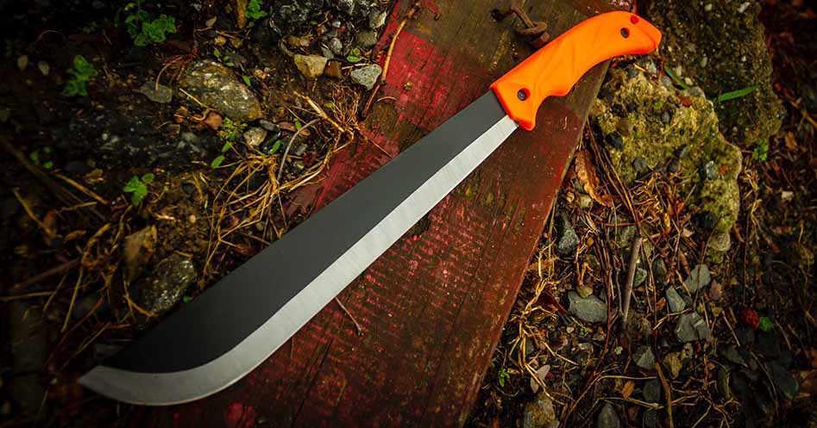
PROPER USE OF TOOLS

Slide 7
MACHETES
Sharpen blades only from 6 inches from the butt of the handle to within 2 inches of the point.
Station machete users at no closer than 10 feet intervals. Protect yourself by retaining this minimum safety zone.
While chopping, if possible, lean forward.
Always chop away from the body.
Swing with a full swing at an approximate 45º, but do not overswing or swing too hard.
Clear small vines, etc., before cutting larger vegetation.
Right-handed: Right foot forward - when swinging downward toward the left or when swinging upward to the right. Left foot forward - when swinging downward toward the right or when swinging upward to the left.
Left-handed - reverse the right-handed procedure.
Do not use machetes for heavy cutting.
Use long-handed lopping shears or brush hooks instead of machetes for cutting thorny bushes and briars.
Wear eye protection.

Slide 8
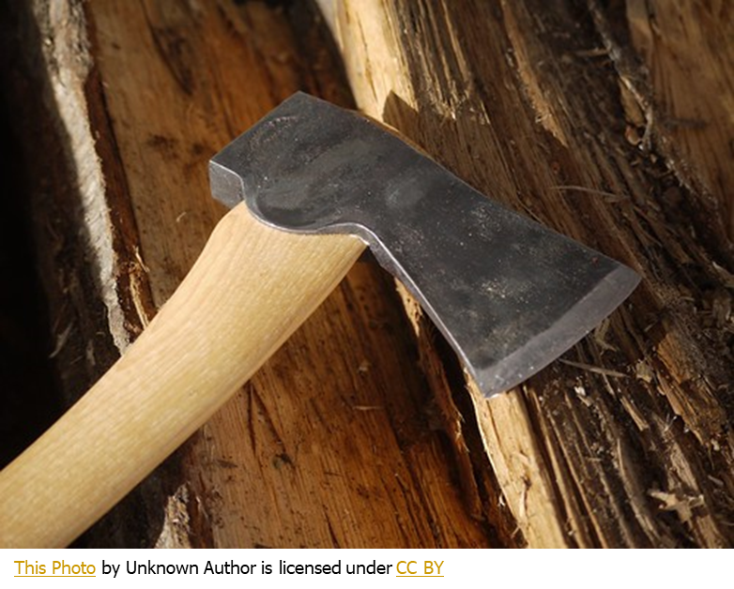
AXES AND BRUSH HOOKS
Clear away any impeding, light growth with a machete or a hatchet before chopping.
Allow ample space between adjacent chopping and keep unessential persons outside the area.
Carry with the handle grip behind the head and the cutting
edge facing outward.
Do not use double-bit axes.
Extended heavy brushing should be cut with a chain saw.

Slide 9
HAND DRIVING TOOLS
Use the right type and right size tool for each driving operation.
Check for defects before using
Do not use hatchets, axes and other wood cutting or driving tools for driving or hammering metal.
Avoid striking brittle metal with a hammer because bits of steel might chip off and cause serious flesh or eye injuries.
Use safety glasses when driving metal objects or cutting anything except paper.
Do not use tools with splintered or loose handles or with mushroomed or cracked heads (this includes the driving tools and the implement being driven).
Allow ample space for the swinging required. When squatting, use either a short-handled tool, or keep the long handle from between your legs (groin injury can result).
When swinging, have the handle horizontal when the face of the driving head contacts the object being driven. Use of long-handled sledges requires flexing the knees to lower the body during the swing.
Do not use a full swing to drive objects that are more than waist high.
Do not hold an object for someone to drive by full-swinging.
When driving masonry nails, spikes, or stakes into pavement or very hard earth, use extra care. Be sure the object being driven is well started before releasing it and driving it with full swings of the hammer.

Slide 10
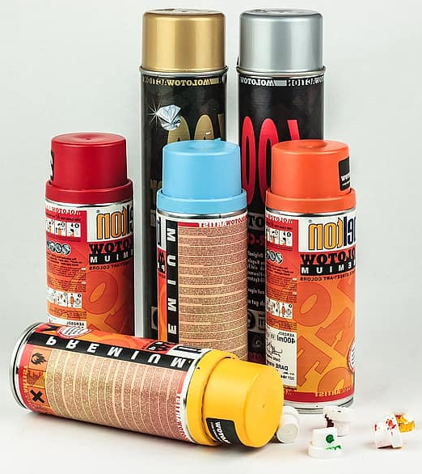
PRESSURIZED SPRAY CANS
Serious injuries and costly cleanup have resulted from improper handling of pressurized spray cans.
Do not puncture or incinerate.
Store at temperature lower than 120F.
Do not carry in vehicle passenger compartments or on dash boards.
Dispose of through local refuse disposal systems.
Do not discard any spray cans in a receptacle that is normally accessible to children.

Slide 11
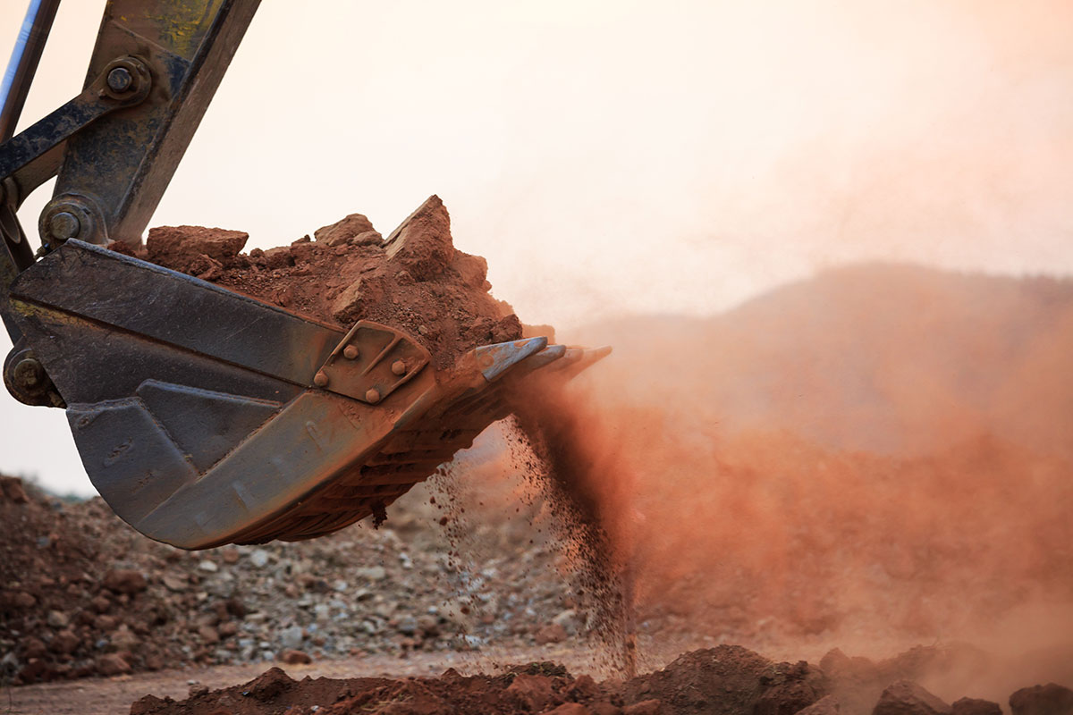
EXCAVATION

Slide 12
Excavations that are less than four feet in depth do not require a stairway, anchored ladder, or ramp. Excavations that are four or more feet in depth require one of these structures, or other safe means of access and egress. This prevents employees from having to travel more than 25 feet to get out of the excavation from any point within the excavation.
Also, walkways must be provided where employees or equipment are permitted to cross over excavations. Guardrails, complying with OSHA requirements, must be provided where walkways are 6 feet or more above lower levels. Stay aware of your surroundings. Never go beneath loads handled by lifting or digging equipment.
Stay away from vehicles being loaded or unloaded, to avoid being struck by any spillage or falling materials. Operators can stay in vehicle cabs that are being loaded or unloaded when the vehicles are equipped to provide adequate protection for the operator.
Warning devices are required if mobile equipment is operated next to or near the edge of an excavation and the operator does not have a clear view of the edge of the excavation. Warning systems include barricades and stop logs, and hand or mechanical signals. If possible, any grade should be sloped away from the excavation.

Slide 13
Keep emergency rescue equipment on hand. A breathing apparatus should be on site, as well as a safety harness and lifeline, both of which are required in confined spaces, and a basket stretcher.
To prevent surface water from entering the excavation and to provide adequate drainage of the area next to the excavation, use diversion ditches, dikes, or other suitable methods.
In situations where the stability of nearby buildings, walls, or other structures is endangered by excavation operations, support systems are required. These systems may include shoring, bracing, and underpinning, to ensure stability and protect employees.
In an excavation, you must be protected from cave-ins by a protective system. Protective systems include sloping and bench systems, and support systems, such as aluminum hydraulic shoring. These systems must have the capacity to resist any reasonably expected load that could be applied to the system.

Slide 14
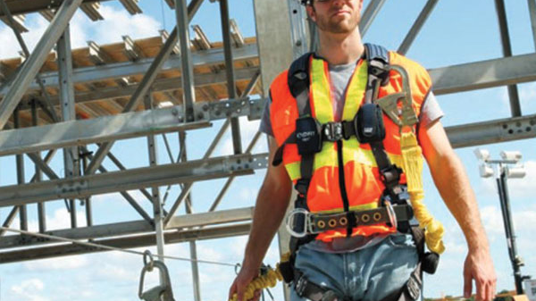
FALL PROTECTION

Slide 15
INSTRUCTIONAL VIDEO
Basics of Fall Protection
(Click the link above to watch video!)

Slide 16
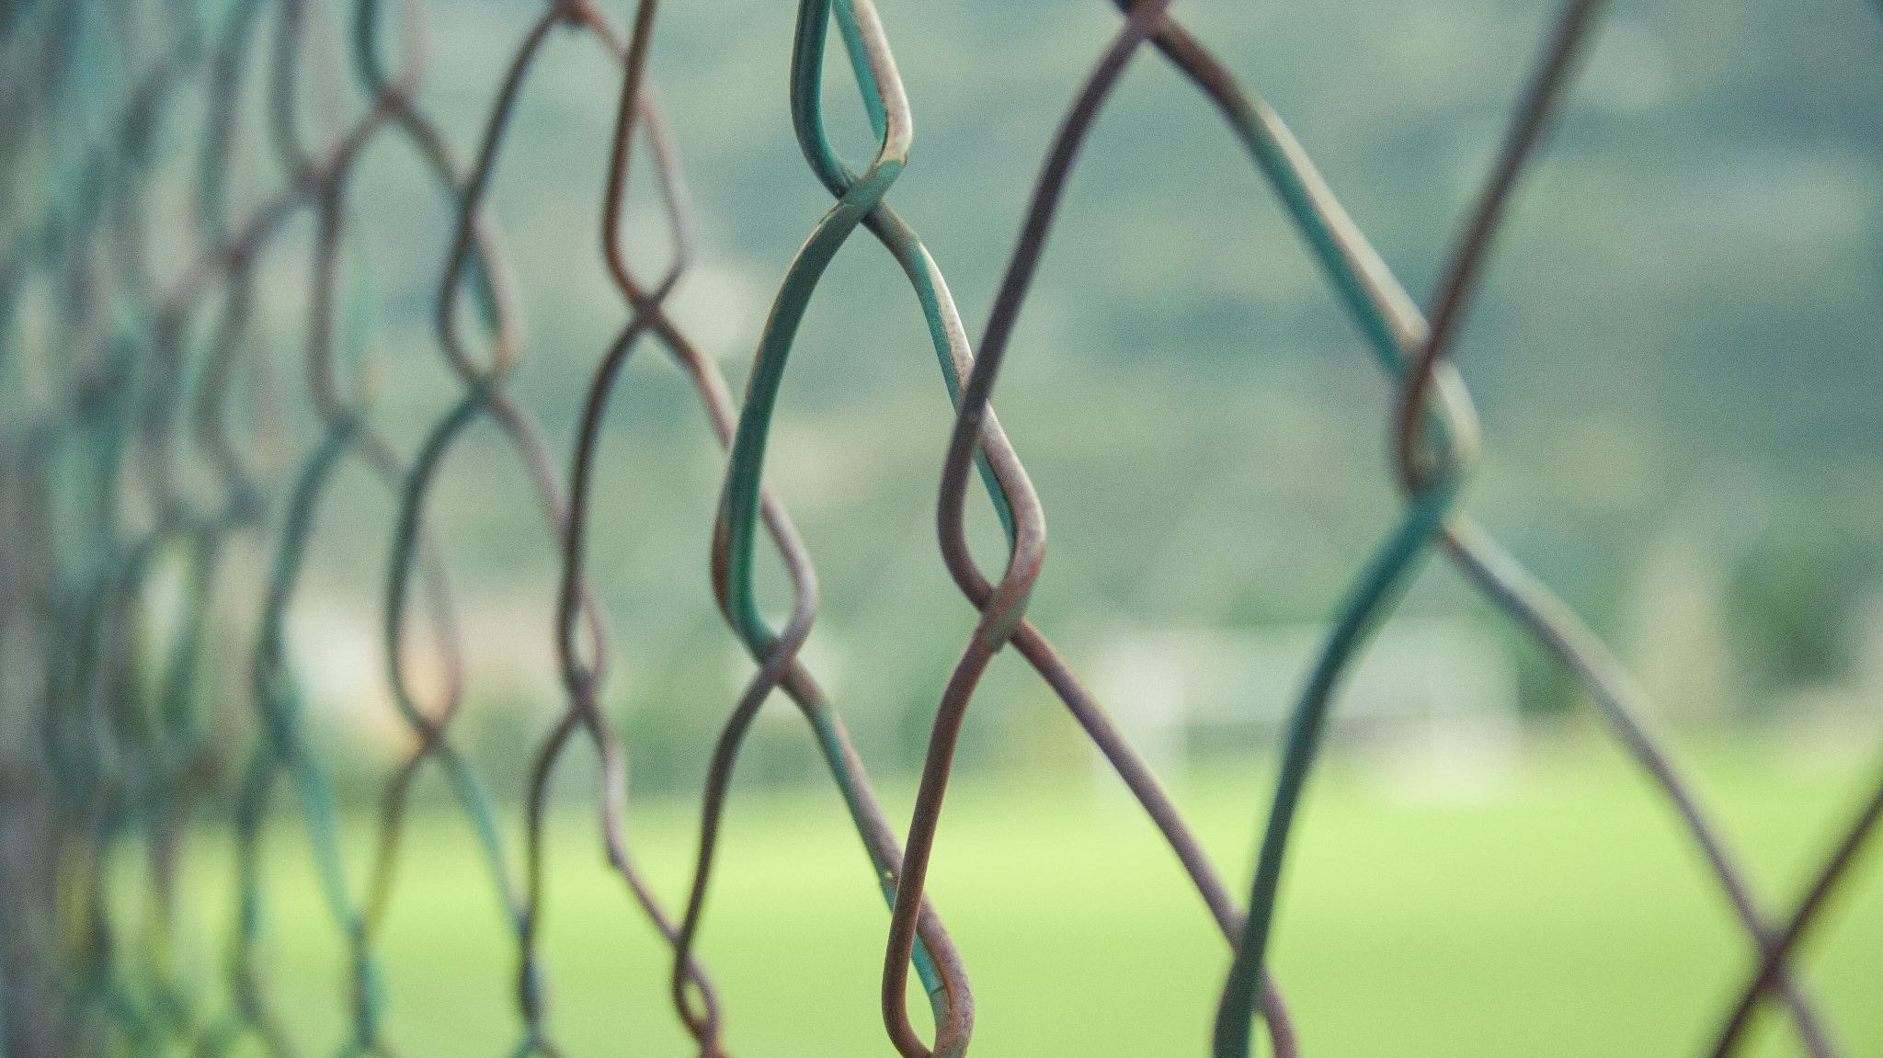
FENCE CROSSINGS

Slide 17
Use gates when possible and avoid crossings.
Use portable chain link fence climber steps or a trestle ladder.
Do not attempt to carry anything when climbing on or over obstacles.
Cross barbed wire fences at the center of a span and have a co-worker hold the wire(s) for you.
When stepping over a barbed wire fence, lay a piece of heavy canvas, such as an empty material bag, over the top strand.

Slide 18

WORKING IN TRAFFIC

Slide 19
WORKING WITHIN AN OPERATING
RIGHT-OF-WAY
Always wear high visibility apparel (Orange vests).
Wear PPE, such as hard hats and hearing protection, depending on the type of work being done.
Post signs to clearly inform motorists of approaching activity and to guide drivers.
Use visual safety devices, such as cones, to get the attention of motorists and deter construction vehicles and equipment away from workers.
Be aware of equipment travel paths and avoid standing or walking in these areas.
Listen for reverse signal alarms in the area.
Know where blind spots exist for different types of equipment.
Never use a cell phone when working around heavy machinery.

Slide 20

WORKING NEAR RAILROADS

Slide 21
WORKING WITHIN AN OPERATING
RIGHT-OF-WAY
Always notify railroad company or authority of survey work to be done within the railroad right-of-way.
Always be alert around railroads. Railroad equipment is not always heard, especially if there is other noise. If a railroad car or locomotive is coasting, or if a train is moving slowly, hearing alone might not provide adequate protection. When necessary, use a lookout.
Never crawl under stopped cars and do not cross tracks between closely-spaced cars, they might be bumped at any time (the engineer and brakemen work only one side of the train).
Do not leave protruding stakes or any holes within 10 feet of the centerline of the tracks.
Do not park vehicle within 10 feet of the tracks; train crews need this area for their operations.
When taping across railroad tracks, support steel tapes above the rails at all times. The contact of both rails simultaneously by a steel tape can activate signals even when laid parallel to the rails. Therefore, only nonmetallic tapes should be grounded.

Slide 22

WORKING IN WATER

Slide 23
BOATING OPERATIONS
Smoking in boats is prohibited.
Employees shall not be authorized to use a boat (with the exception of john boats used in culverts or streams) unless they have successfully completed an approved safety course.
All personnel in boats shall wear U.S. Coast Guard approved life vests.
All boats except john boats shall be required to carry visual distress signals for use during daylight and night operations.
Because certain navigational rules require sound signals, a whistle, horn or bell shall be carried on board all boats, except john boats used in coastal waters.
A first aid kit should be carried in the boat.
Standing in small utility boats while afloat should be avoided.
Unless anchoring both fore and aft, boats shall not be anchored by the stern.
All equipment in the boat shall be secured before getting underway.
Remove portable fuel tanks from the boat before fueling. Wipe off all spilled fuel and oil immediately.
All gas or diesel powered boats shall have at least one Type B-1 hand portable fire extinguisher on board.

Slide 24
WADING
Do not wade barefoot; Wear rubber boots to protect against cuts, cold, and water.
Work with a buddy & wear a life jacket.
In still waters -
Limit wading to waist-deep water. Chest-waders are recommended.
When wearing chest waders, a chest belt shall be worn to prevent the waders from filling if you slip. A life jacket shall be worn with chest waders.
Probe with a pole for holes and soft ground before proceeding
Do not wade if -
The water is more than mid-thigh high.
The product of stream velocity in f.p.s. and stream depth in feet equals ten or more.
Footing is difficult to retain because of any combination of stream velocity, stream roughness or slipperiness, unless a tautly stretched lifeline is used as a handrail.
Do not wear a backpack while crossing a stream. Use a wading staff.

Slide 25
ALONG SHORELINES
Ocean shores -
Wear boots even if you are working only along the edges of the surf.
Schedule work at low tides.
Do not work in the surf unless you are adept at ocean shore swimming and have on a life jacket.
Do not work in heavy surf.
Inland shores –
Wear rubber or leather boots for snake protection
Do not walk on floating debris, in reservoirs or debris basins.
Be cautious of recently puddled trenches and dredging fills.

Slide 26

POWER LINES & ELECTRICAL STORMS

Slide 27

Regard all power lines as dangerous.
Avoid actual contact with or possible arcing to any equipment from electrical lines. In damp conditions, double your precautions.
Do not tape across terrain where a tape might possibly be pulled up, into, or lowered atop a power line. Use an Electrical Discharge Machine or another form of tachymetry instead of taping.
Power line elevations - do not make a "direct" measurement of the height of a power line, even with a fiberglass rod. Triangulate these vertical distances.
If an electrical storm approaches while you are working, discontinue working and seek shelter.
Do not use any metal objects, such as chains, transits, E.D.M.'s, levels, range poles or Philadelphia rods during an electrical storm.
The best thing to do is to get into your truck or building and wait out the storm.
This Photo by Unknown Author is licensed under CC BY-SA

Slide 28

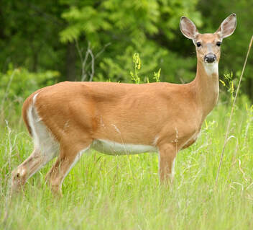
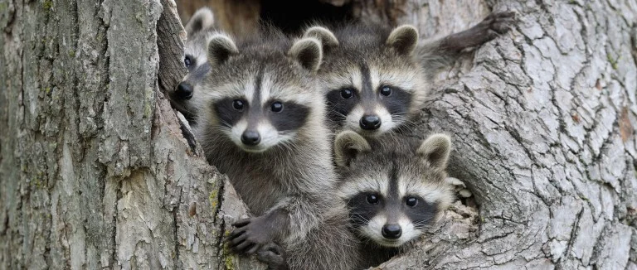
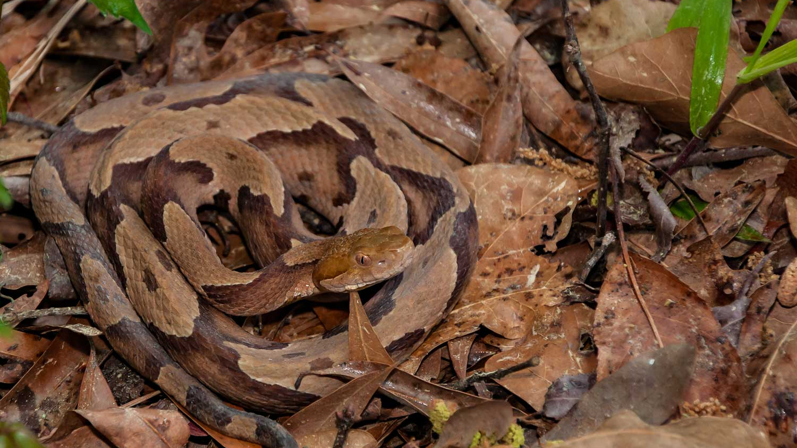


ANIMAL HAZARDS

Slide 29
Assume that all animals are potentially dangerous.
Have owners secure hostile-acting animals before entering enclosures containing such animals.
Do not enter an enclosure with high fences if a hazardous animal is within.
Carry a pointed lath or a range pole to ward off an attacking animal. Retreat is usually advisable but do not turn your back and run unless you can reach a refuge before the animal reaches you.
Do not approach, attempt to capture or kill, or attempt to pet either domesticated or wild creatures (this includes snakes and other reptiles).
Be especially wary of sick-appearing animals, animals with young, stallions, bulls and guard dogs.
Do not handle dead or seemingly dead animals, fowl or reptiles.

Slide 30
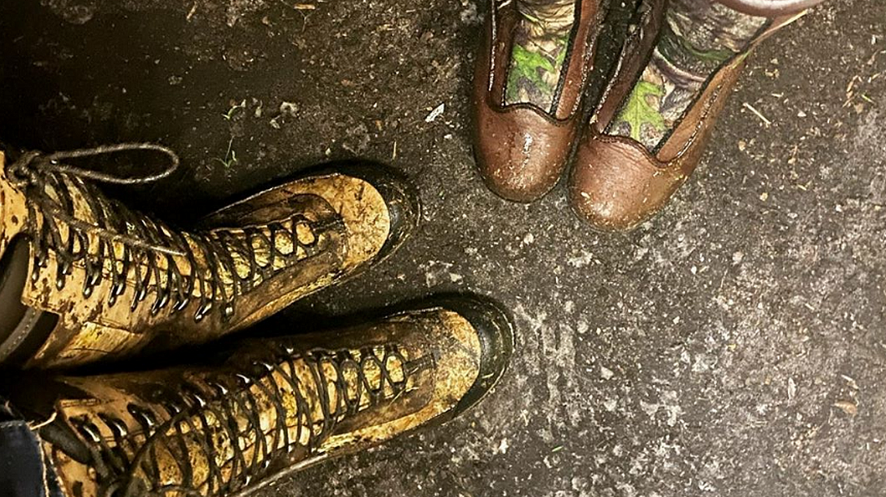
SNAKE BITE PREVENTION & PLANNING

Slide 31
Venomous snakes bite 7,000 to 8,000 people in the United States annually.
Always take the following precautions:
Always assume snakes are active. Do not relax your vigil on sunny winter days.
Do not make "solo" trips across snake country which is remote from habitations and frequently used roads.
When traversing brush or grassy terrain, use a "decoy" such as a level rod or a lath, alongside your legs.
Walk heavily to create vibrations that can be felt by snakes (a snake does not hear).
Walk away from the shaded side of clumps and bushes when the weather is hot and sunny.
Step atop logs and large rocks, instead of stepping over them and into unseen areas. The safest policy is to walk around such obstacles.
Do not jump down from overhangs onto areas where snakes might be hidden from view.
Avoid steep climbs if possible where a snake, uphill from you, could strike the upper portions of your body. Bites on the torso, the neck, and the head are much more damaging and more difficult to treat than those on the limbs.
Continued on Next Slide

Slide 32
Never climb vertical or near vertical faces where handholds on unseen areas above your head are required.
Do not attempt, under any circumstances, to capture snakes!!
Do not try to kill a snake unless it is a positive threat to safety.
Avoid likely snake areas such as small rodent trails, pack rats' nests or gopher tortoise dens.
When necessary to move low-lying logs, large rocks and boards, use a pry bar, not your hands.
Double your precautions at night, especially in warm weather.
Keep vehicles near your work area for rapid transport if a snakebite should occur.
If possible, maintain radio contact with isolated employee.
Know the location of the nearest medical facility where antivenin is available and the quickest route there.
Do not collect rattles. A fine and highly abrasive dust often accumulates inside the rattles and can cause lasting damage to the eyes.
Wear high leather boots or snake-leggings in high-hazard areas.
Remember that rattlesnakes do not always signal their presence by rattling.

Slide 33

IF A SNAKE BITE OCCURS

Slide 34
Should you be bitten by a snake, it’s essential to get emergency treatment as quickly as possible. However, there are some tips that you should also keep in mind:
1. Call 911 immediately.
2. Note the time of the bite.
3. Keep calm and still as movement can cause the venom to travel more quickly through the body.
4. Remove constricting clothing or jewelry because the area surrounding the bite will likely swell.
5. Don’t allow the victim to walk. Carry or transport them by vehicle.
6. Do not kill or handle the snake. Take a picture if you can but don’t waste time hunting it down.
Venomous snake bites can produce an array of symptoms, including localized pain and swelling, convulsions, nausea, and even paralysis.

Slide 35

VENOMOUS SNAKES

Slide 36
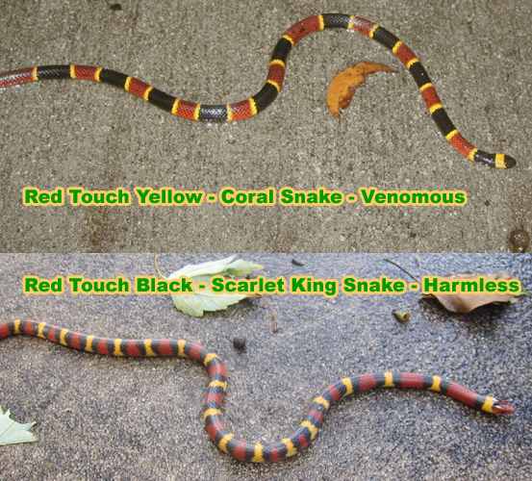
Coral Snakes (may be easily confused with Scarlet King Snakes)
Coral snakes vary widely in their behavior, but most are very elusive.
Coral snakes are not aggressive or prone to biting and account for less than 1% of the total number of snake bites each year in the U.S.
“Red Touch Yellow, Kills a Fellow;
Red Touch Black, Friend of Jack”

Slide 37
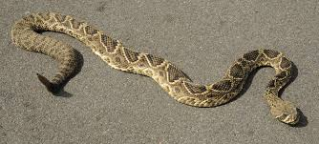
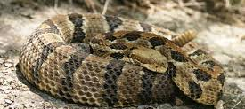
Eastern Diamondback Rattlesnake
Has the reputation of being the most dangerous venomous snake in North America.
Brownish, brownish-yellow, brownish-gray, or olive ground color, overlaid with a series of dark brown to black diamonds with slightly lighter centers.
Canebrake or Timber Rattlesnake
Has long fangs, an impressive size, and a high venom yield.
Gray or yellowish-brown base color, adorned with dark, diamond-shaped blotches. The tail features a series of alternating black and yellow bands.

Slide 38
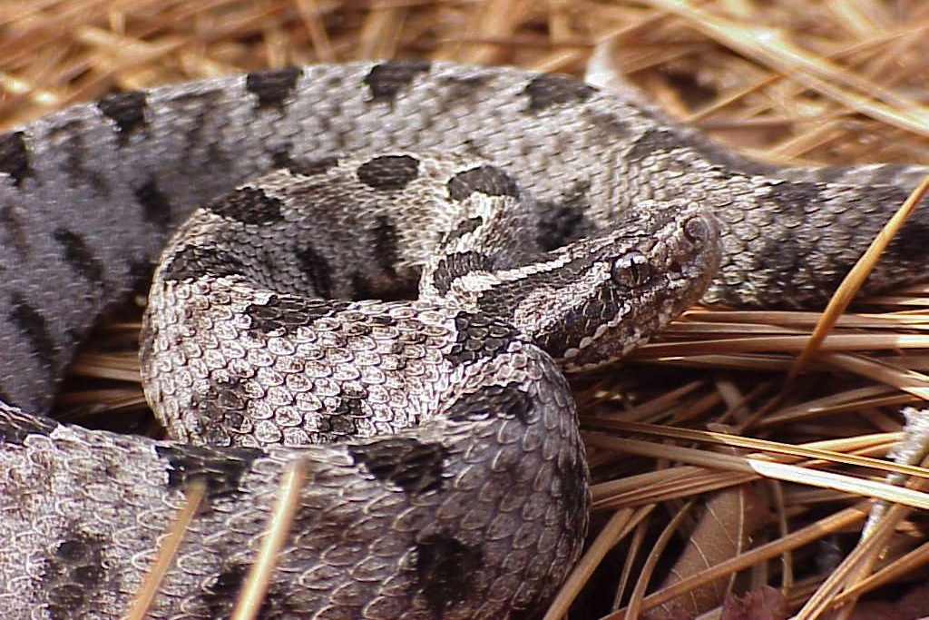
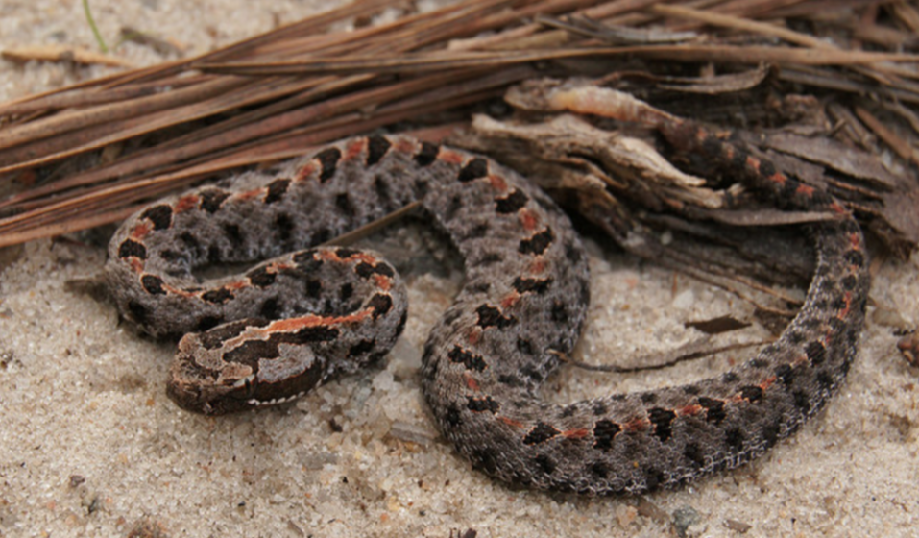
Range in color from tan or gray to brown, adorned with a series of dark-brown or black blotches that form a distinct pattern down its back.
Inhabits flatwoods, sandhills, mixed forests, and floodplains; Also found near lakes and marshes.
Pygmy Rattlesnake

Slide 39
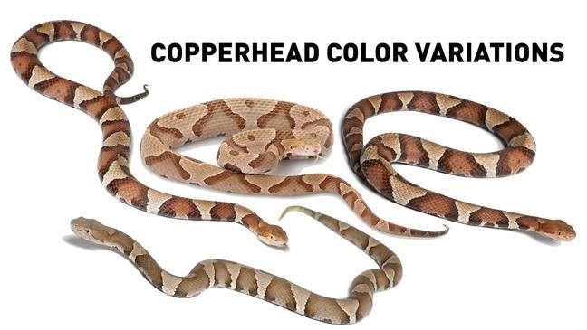
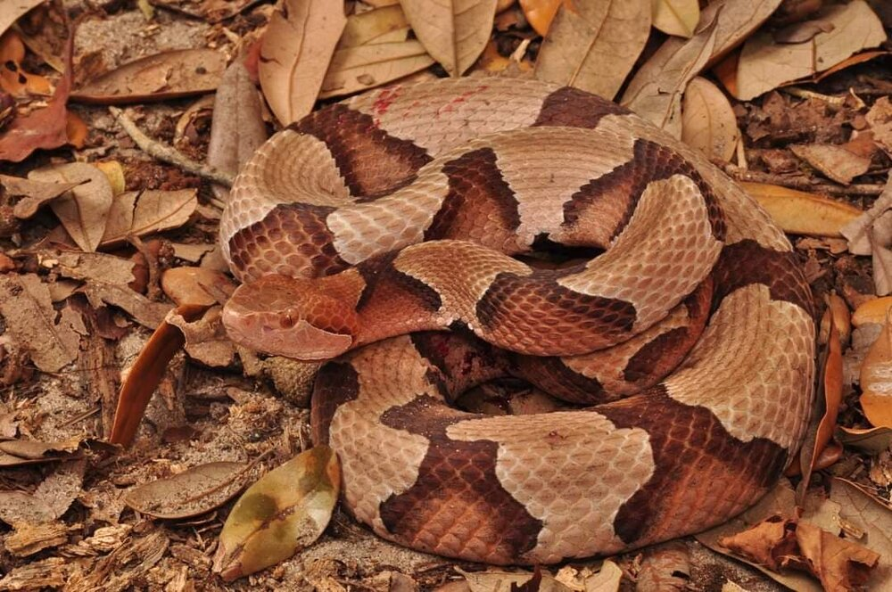
Copperhead
The eastern copperhead has distinctive, dark brown, hourglass-shaped markings, overlaid on a light reddish brown or brown/gray background.
The body type is heavy, rather than slender.
Capable of producing intense pain, tingling, throbbing, swelling and severe nausea.

Slide 40
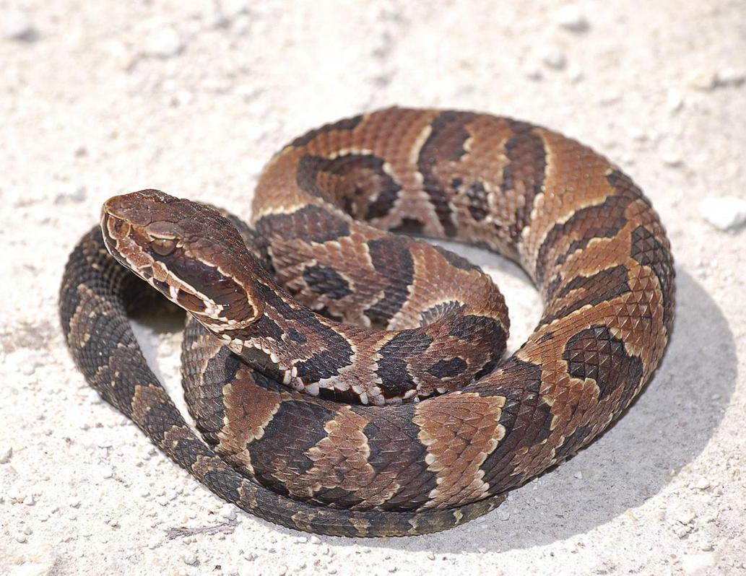
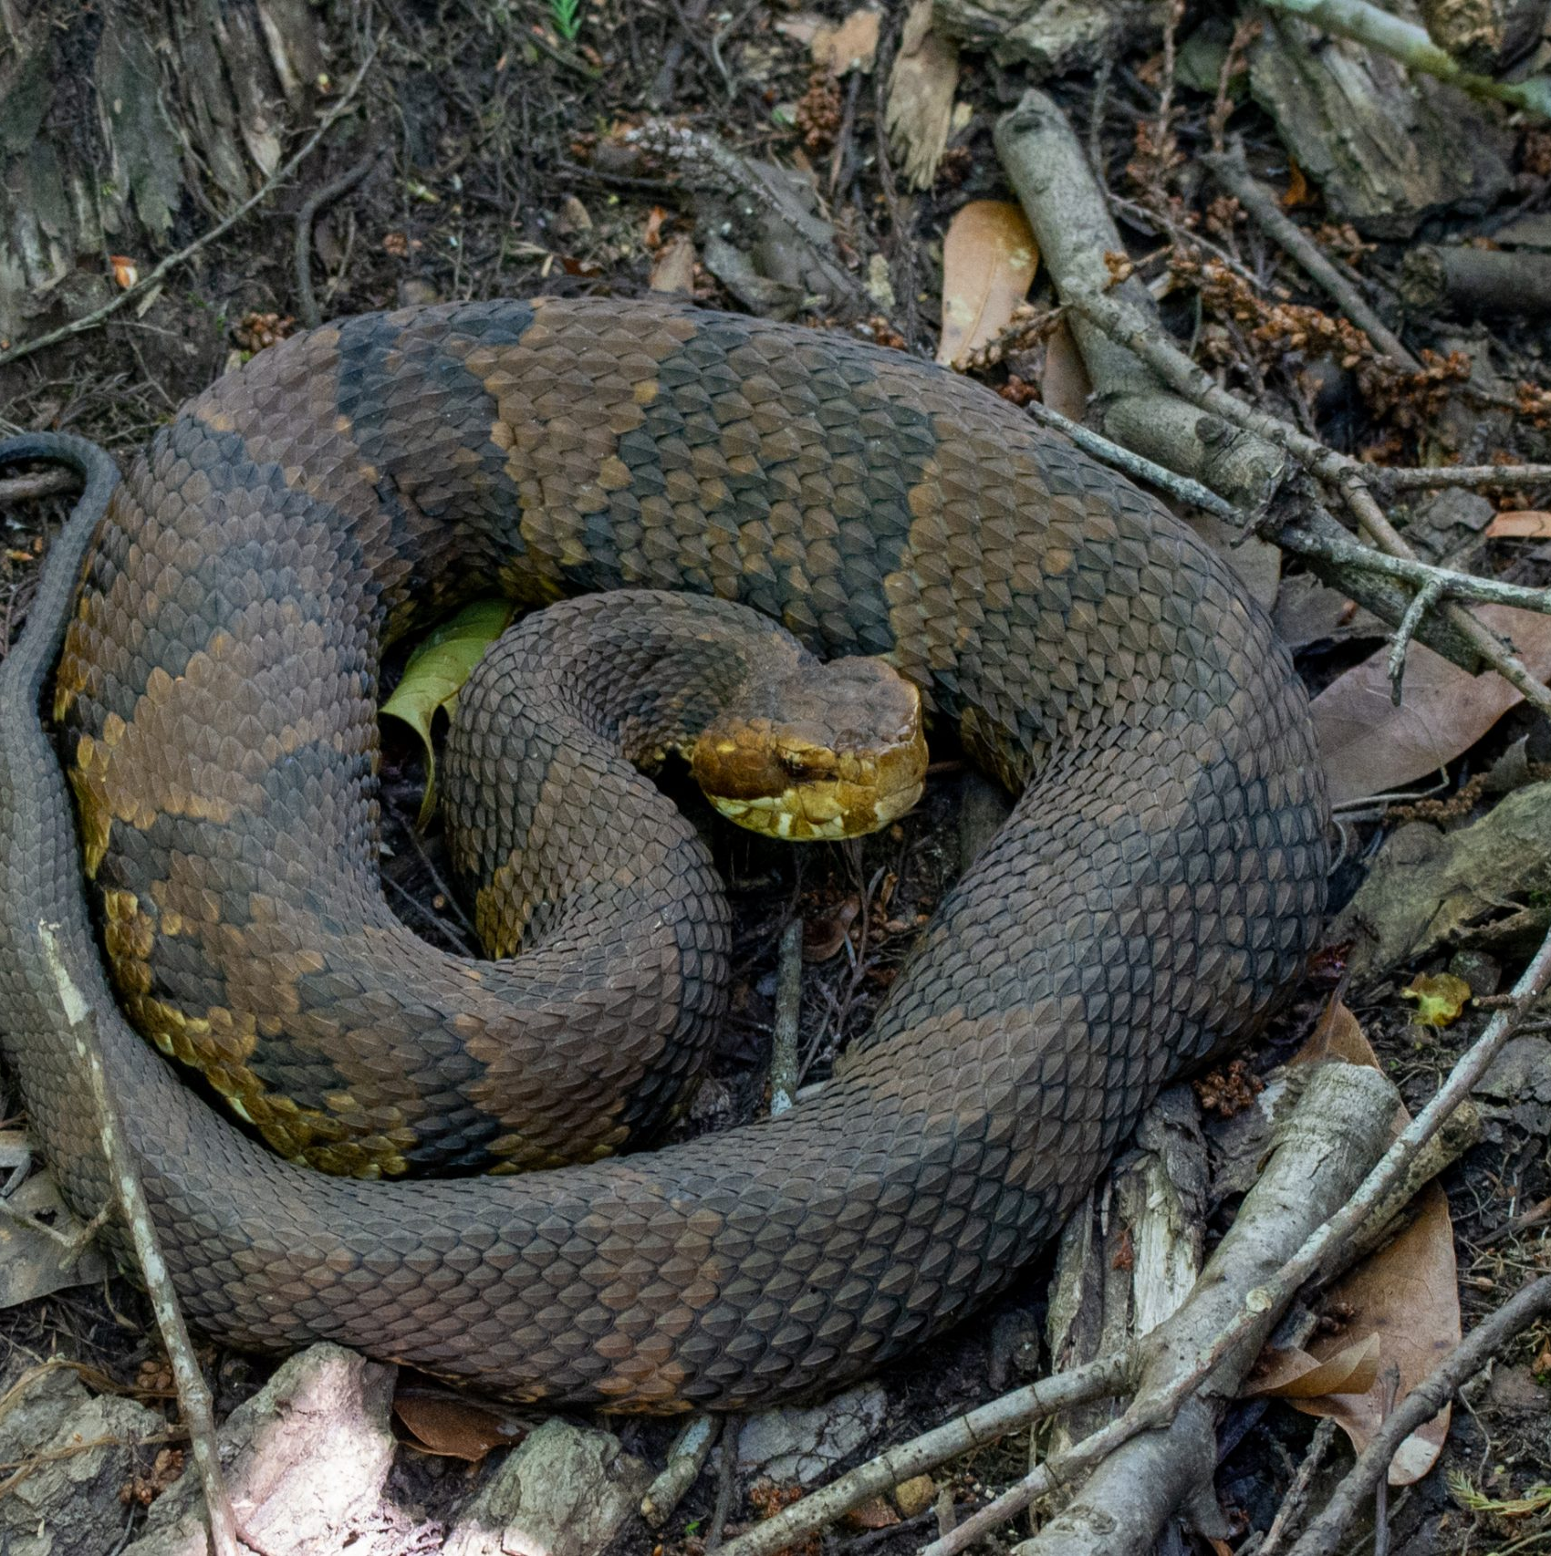
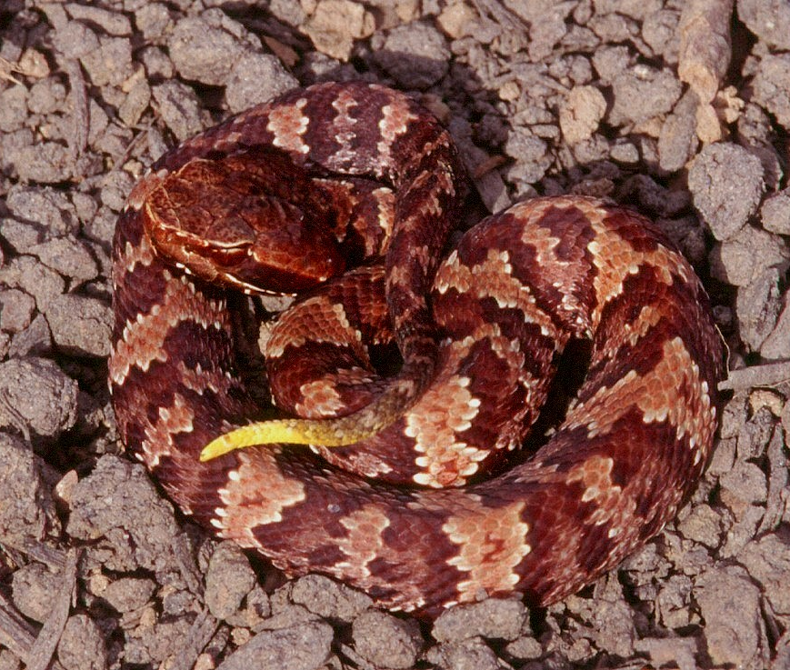
Cottonmouth
(or Water Moccasin)
Cottonmouths, also known as ‘water moccasins’, are venomous heavy bodied snakes. They achieve lengths of 24-48 inches and have keeled scales.
Older adults are usually solid brown to almost black in appearance.
Younger snakes show significantly more patterning with alternating dark brown and light brown cross bands going down the body, and a uniformly dark tail. Juveniles have a yellow tip to their tail.

Slide 41

INSECTS & SPIDERS

Slide 42
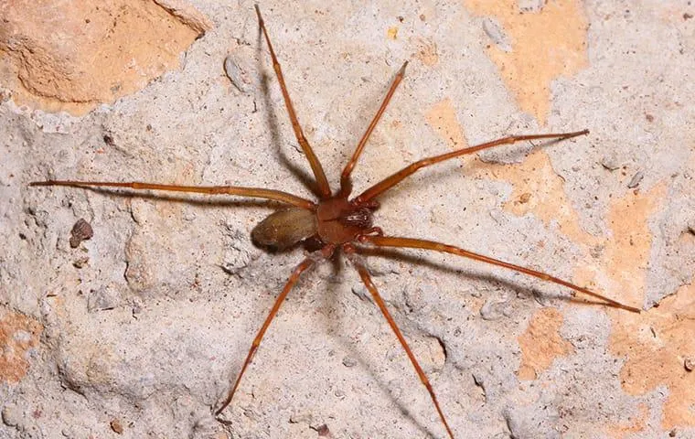
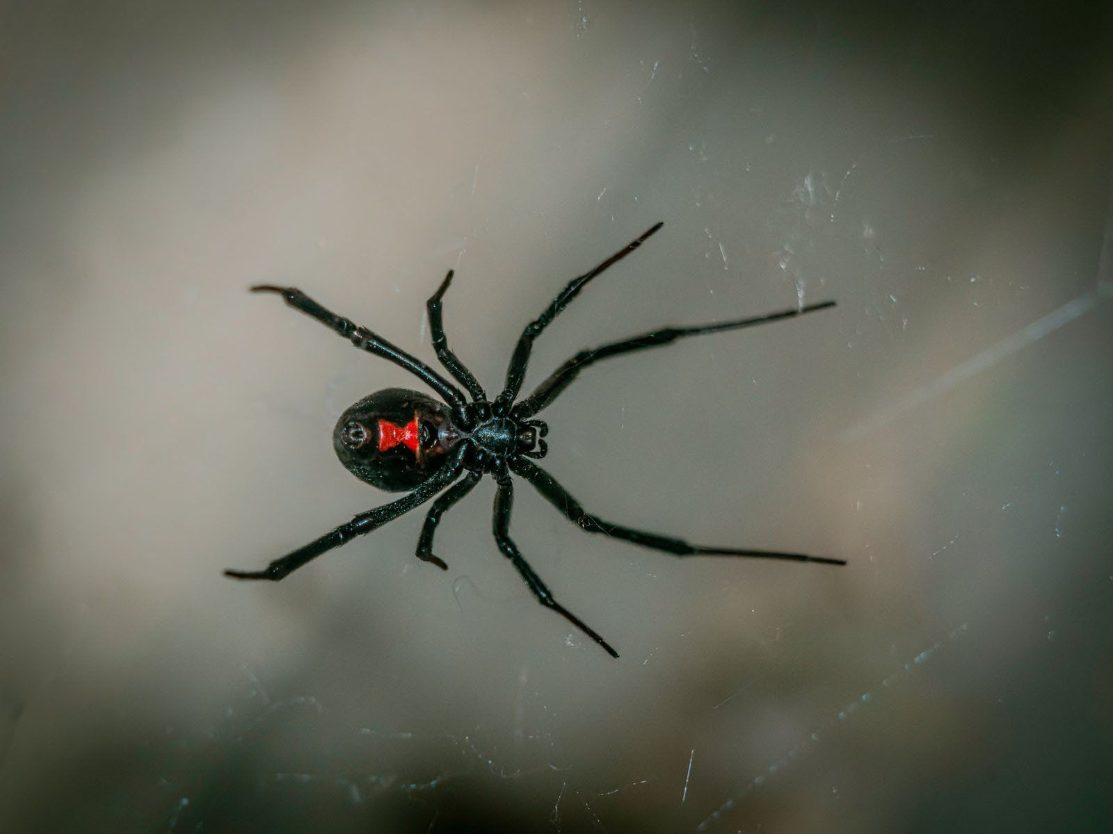
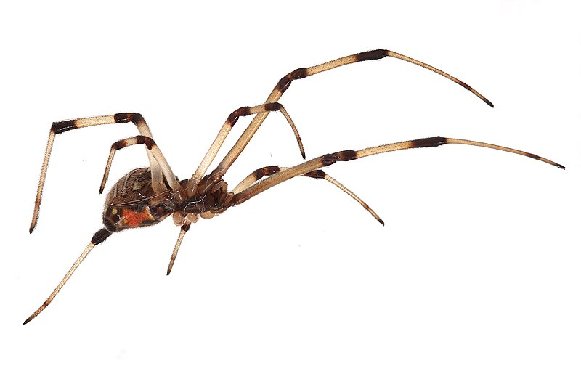
Brown Recluse
Black Widow
Brown Widow

Slide 43
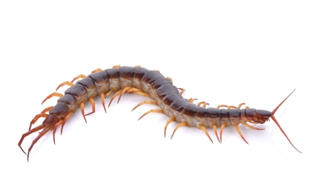

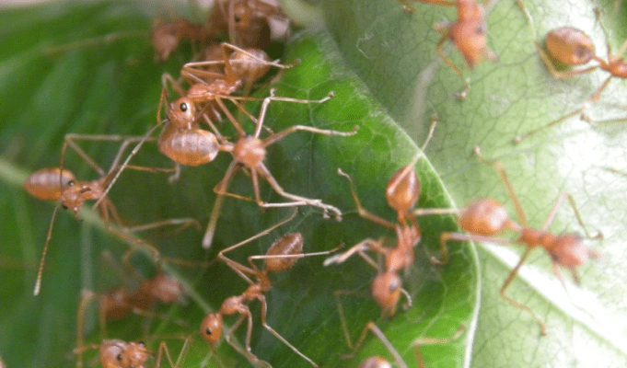
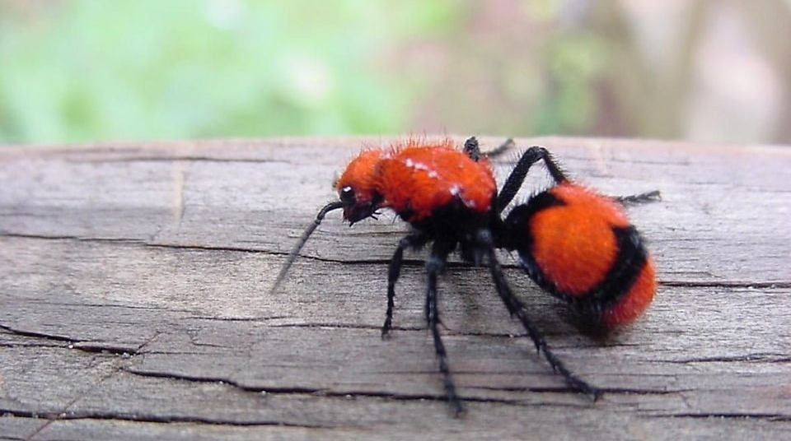
Centipede
Lone Star Tick
Red Velvet Ant (or Cow Killer)
Fire Ants

Slide 44

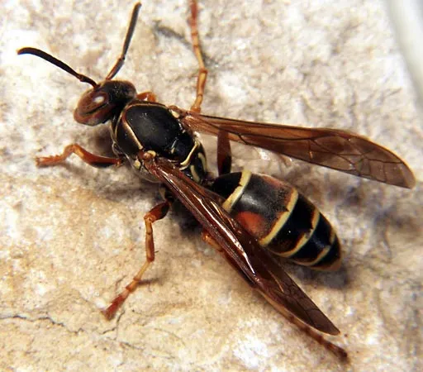
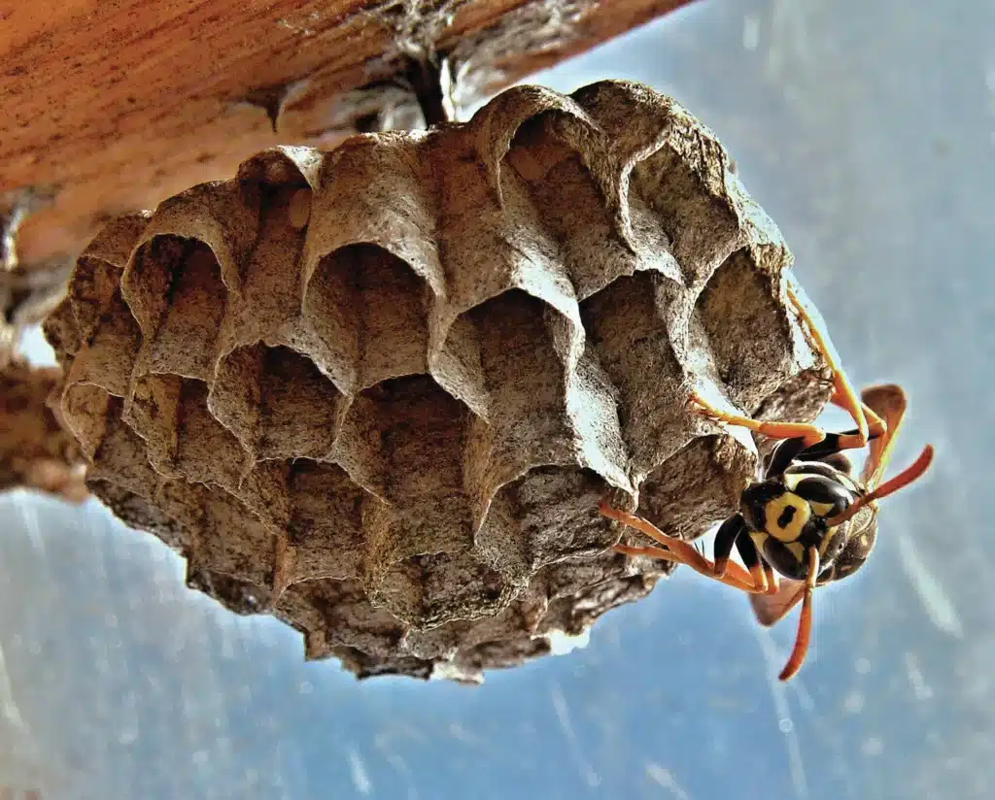
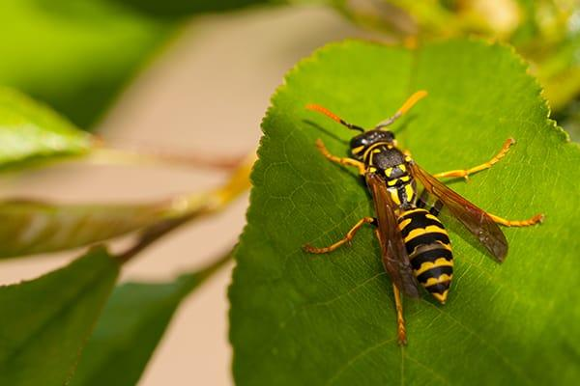
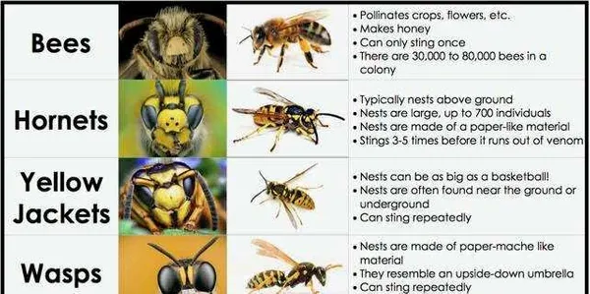

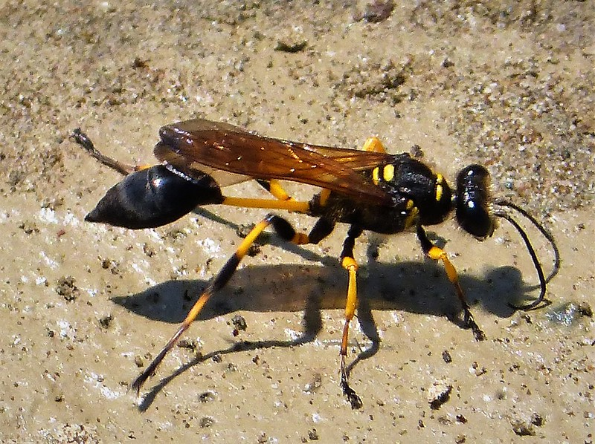

Slide 45

POISONOUS PLANTS

Slide 46

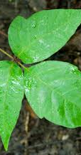
Poison ivy can grow as small plants, shrubs, or climbing vines.
The leaves are shiny and pointed and have prominent veins.
Poison ivy grows along fences and stone walls and in wooded areas.
“Leaves of three, let it be.”

Slide 47


Poison oak is an upright shrub, similar to poison ivy in appearance, except that the edges of the leaves are more deeply notched.
The leaves are arranged in characteristic groups of three.
Effects of poison oak are similar to poison ivy; severe itching, evolves into inflammation, non-colored bumps, and then blistering when scratched.

Slide 48

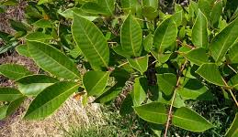
Poison sumac is a shrub or small tree. Clusters of white berries identify the poison sumac from the nonpoisonous sumac.
Grows in wet and clay soils, usually in swamps and peat bogs.

